Slide 1
CUSTOM VPC CREATION
Once you logged in to AWS management console go to VPC.
Choose Your VPCs from left navigation pane then click on Create VPC.
On Create VPC dialog box, add name tag, specify CIDR block, choose Tenancy then click on Yes Create.

Slide 2
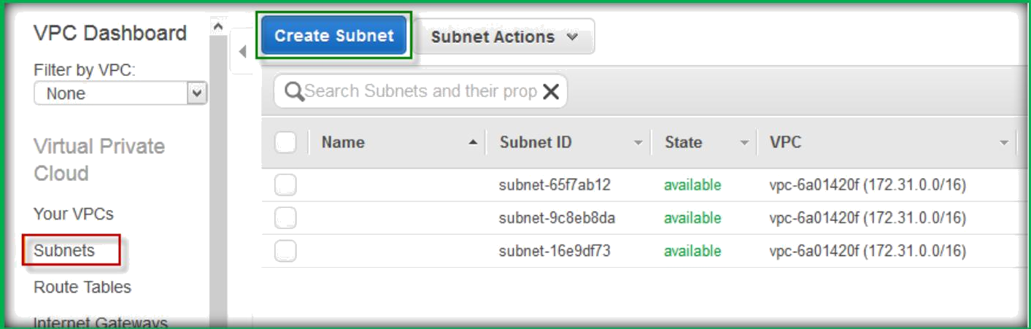
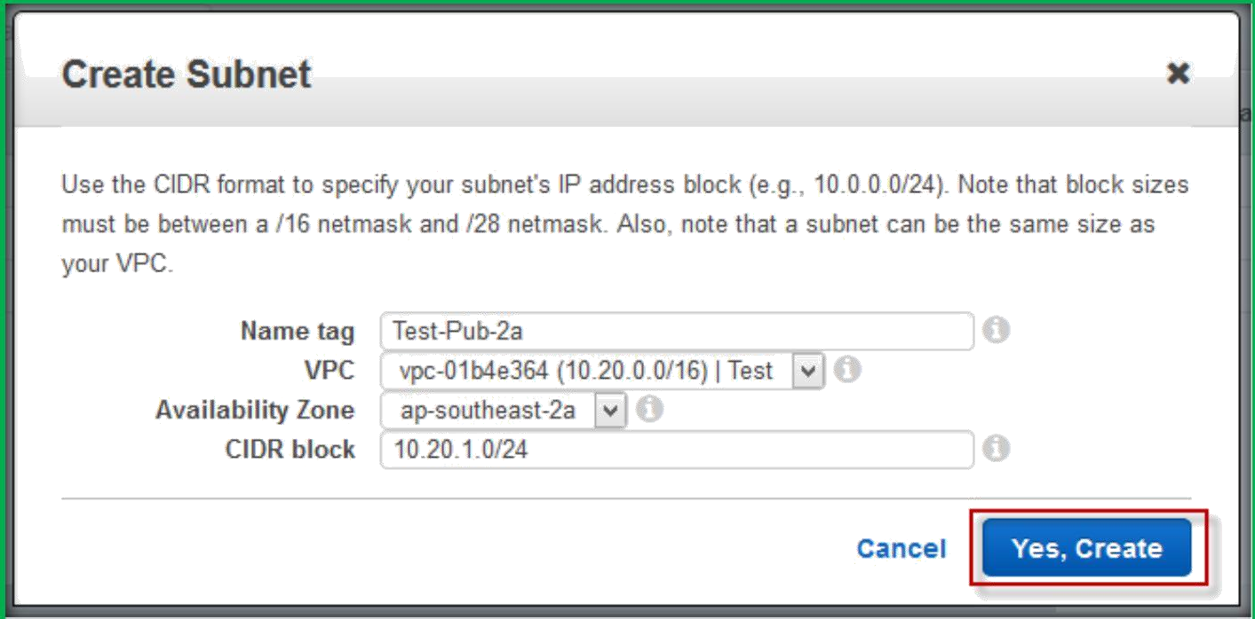
Choose Subnets from left navigation page, then select Create Subnet.
Add a name tag, choose VPC from VPC drop down list, choose AZ from AZ drop down list, specify CIDR block for your subnet, then click on yes Create.

Slide 3
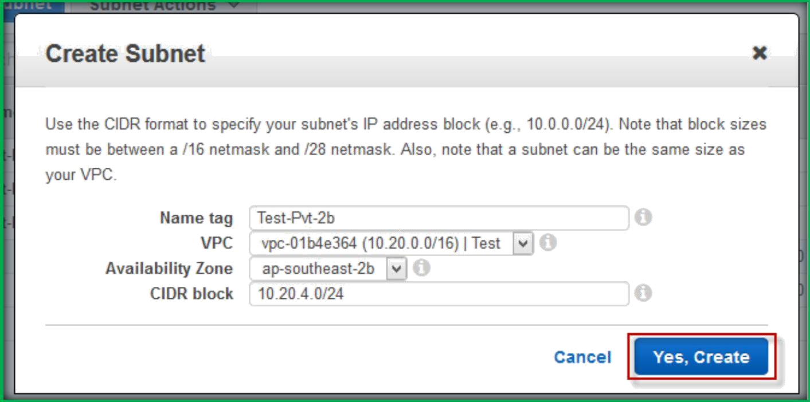
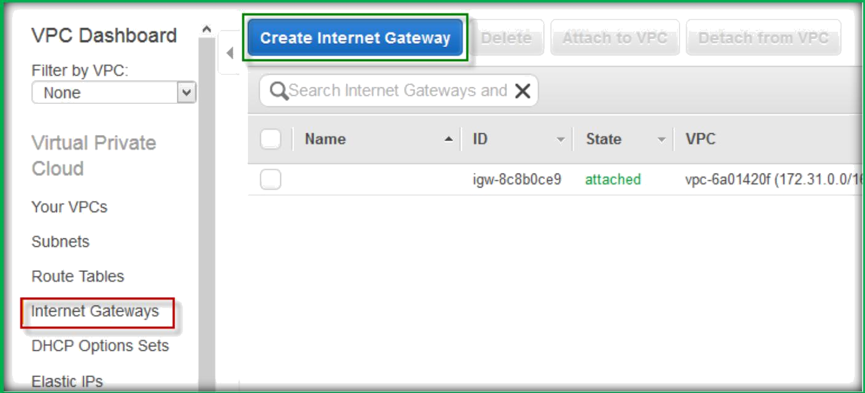
Like same way try to create more subnets differ them with public and private.
Choose Internet gateways from the left navigation page, then click on Create Internet Gateway.

Slide 4
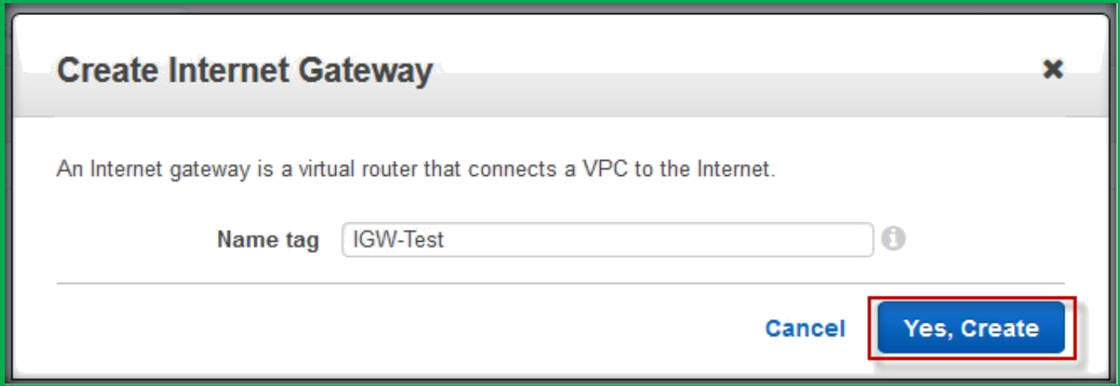
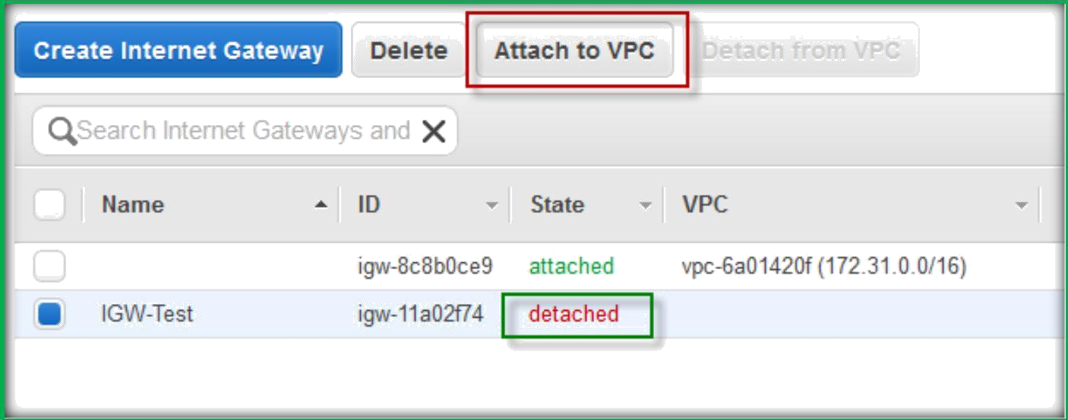
Specify a name tag then choose Yes, Create.
Once Internet Gateway created, it will be in detached state, we need to manually attach it to out VPC.
To do that choose Internet Gateway, select Attach to VPC button.

Slide 5
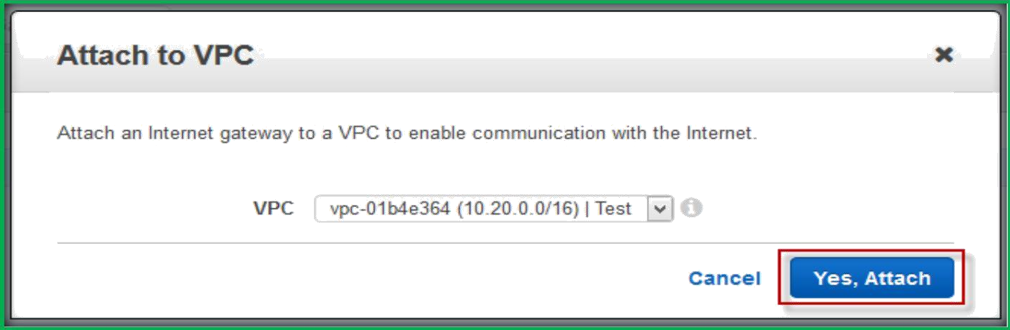
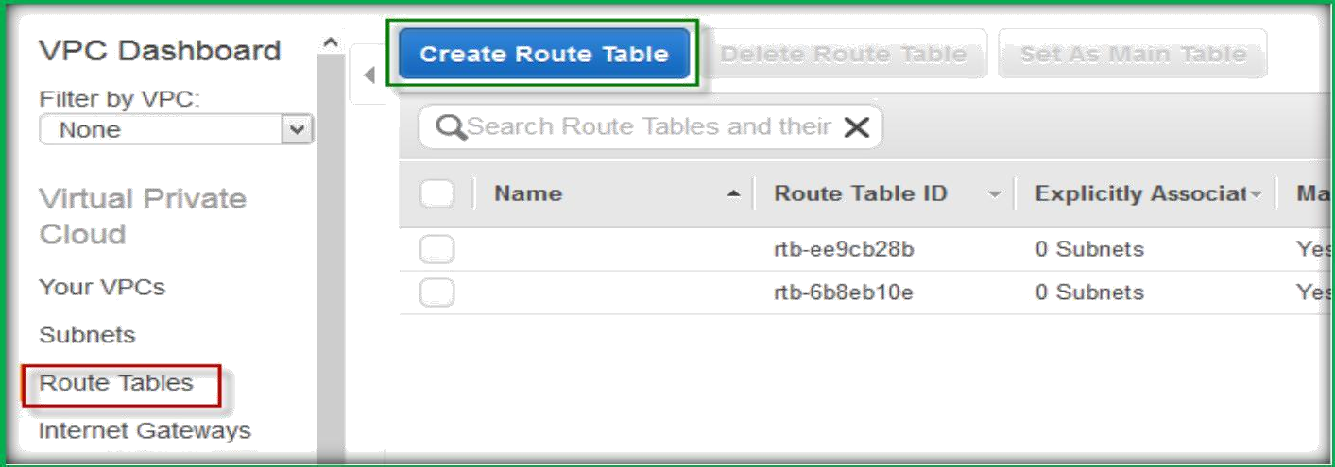
On Attach to VPC dialog box choose your VPC, then click on Yes, Attach
Each subnet in VPC must be associated with Route Table.
Choose Route Tables form the left navigation pane, click on Create Route Table.
On Create Route Table dialog box, specify a name tag, choose your VPC from VPC drop down list, then click on Yes, Create.

Slide 6
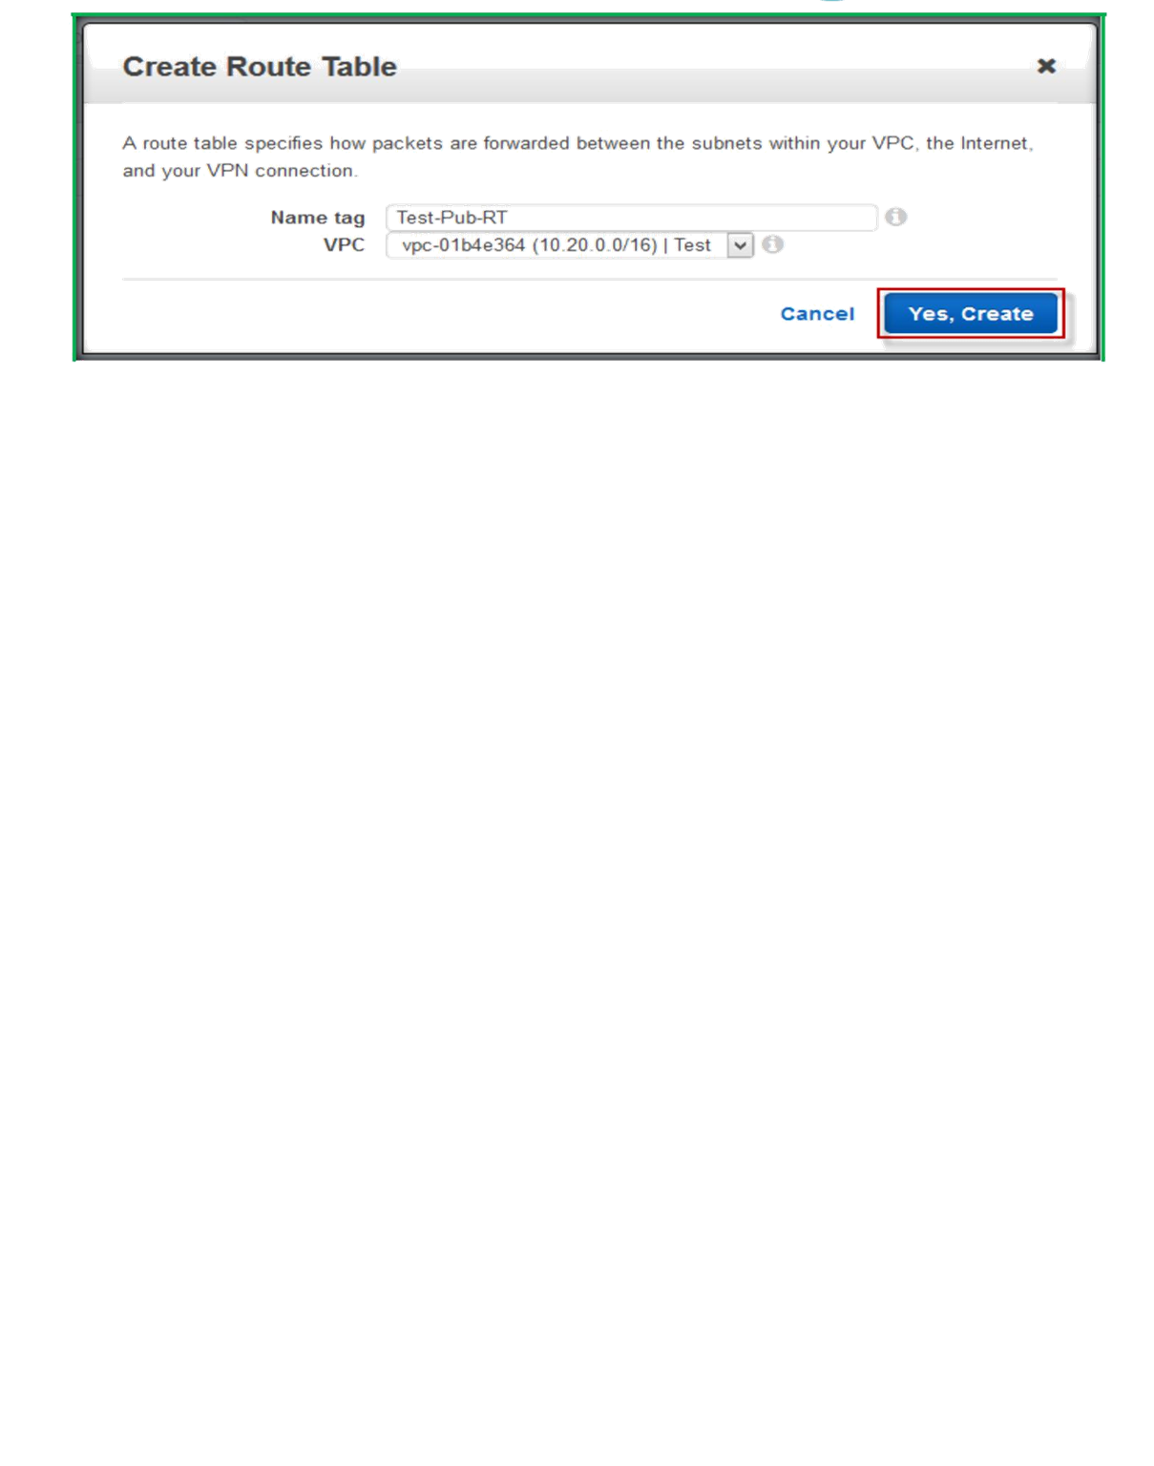
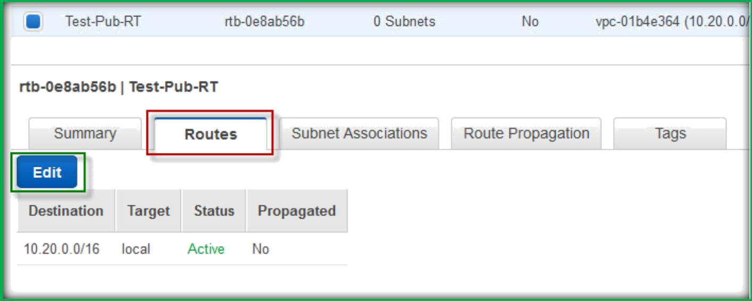
Once created choose the Route Table, under Routes click on Edit button.
click on Add another route to create a new rule which we are going to attach to Internet Gateway.

Slide 7
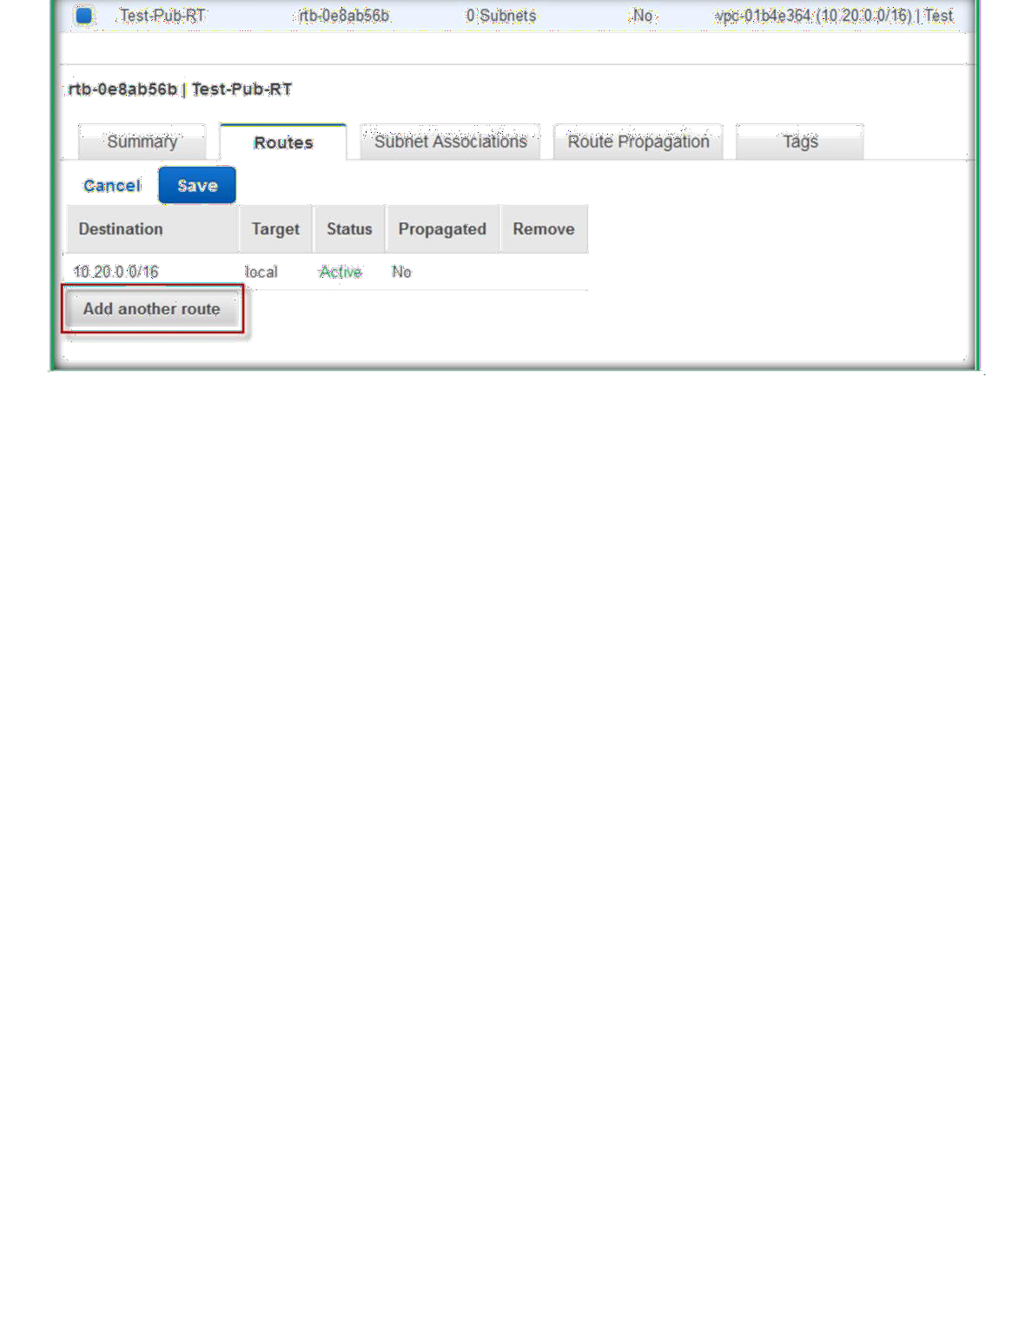
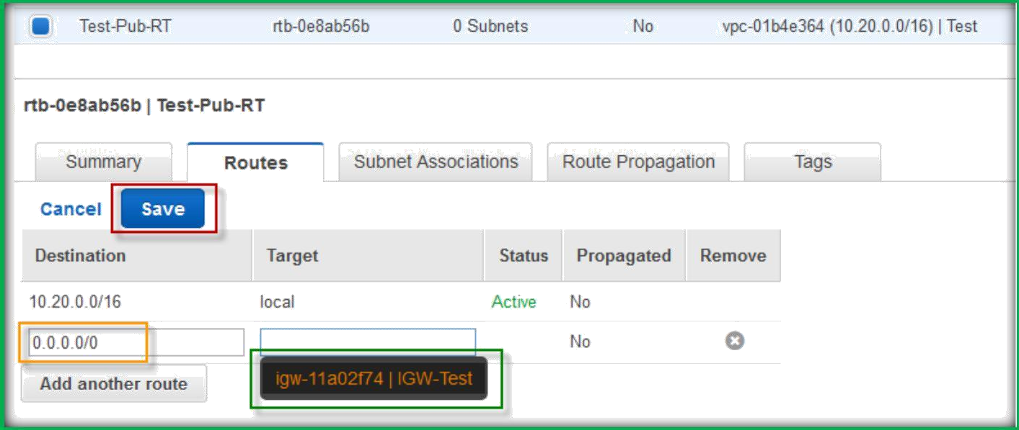
Specify destination as 0.0.0.0/0 and choose target as Internet gateway, then click on Save button to save.
then choose Subnet Associations and click on Edit button to add Subnets to this Route Table.

Slide 8
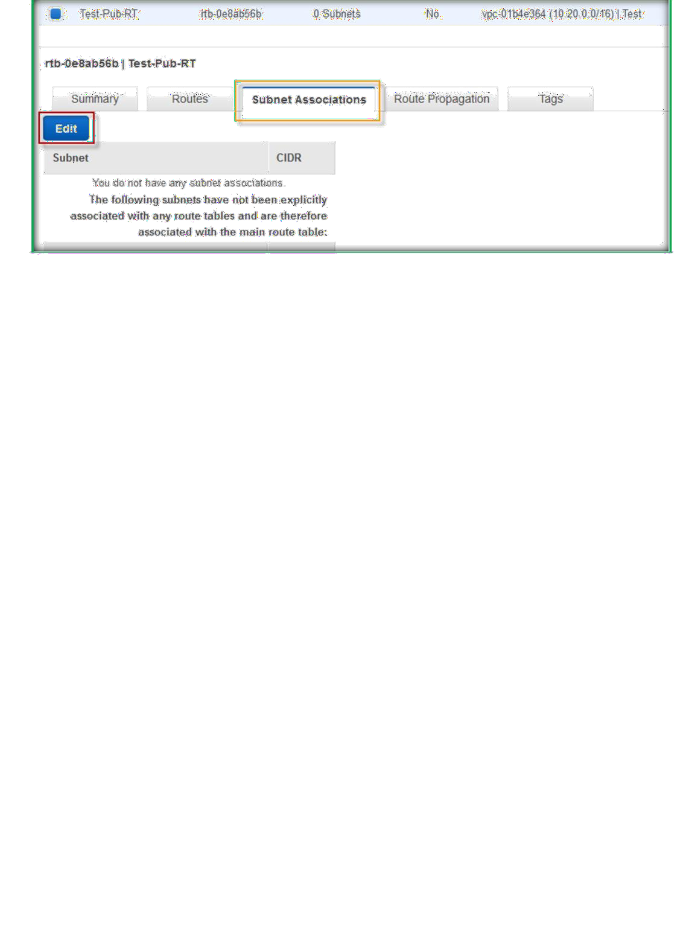
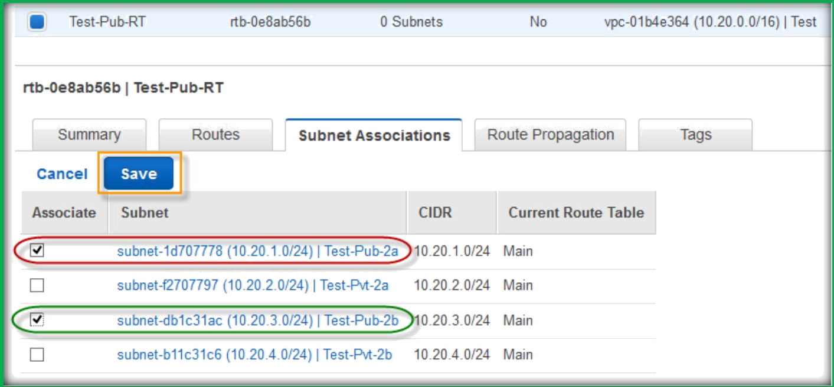
Under Subnet Associations, select the subnets which you want to attach it and click on Save button.

